Slide 1
EXPLORING THE MOVIE DATABASE(2010-2019)
Analysis of the IMDB data
BY MICHELLE OWINO

Slide 2
SUMMARY OF THE INITIAL EXPLORATION OF THE DATA SET
145,081 movies from 2010 to 2019, with 73,856 (about 51%) rated
Releases grew about 48% from 2010 (11,849) to 2017 (17,504)
2019 has only 8,379 movies, so the data looks incomplete
Typical runtime is 91 minutes the median
Average rating differs by runtime: 6.22 for 90 to 119 minutes up to 6.64 for 150+ minutes

Slide 3
BUSINESS QUESTION.
Why do the standard length movies that have a runtime of between 90 to 119 minutes have a lower rating that both the shorter movies that have a runtime of under 90 minutes and the longer movies of 120+ minutes. Is this because of the genre or by how many people rated the movie?

Slide 4
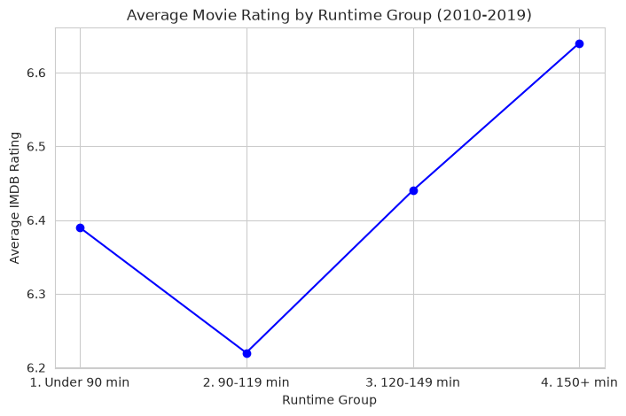
CHART VISUAL.

Slide 5
Data cleaning tasks
Missing runtimes: 21.2% of all movies (10.3% of rated movies)
Missing genres: 3.7% of all movies
Impossible runtimes (3 to 51,420 minutes) need checking and capping
Genres stored together in one cell (“Action,Crime,Drama”) and need splitting
2019 data is incomplete (about half the usual number)
Only about half of movies have ratings
Original titles missing for 20 movies; titles are in different languages and need standardising

